Slide 1
Improving Deep Neural Networks
Deep Learning Specialization Report
Toshiba Software Development (Vietnam) Co., Ltd.
2021-10-14

Slide 2
Contents
01
Practical Aspects of Deep Learning
02
Optimization Algorithms
03
Hyperparameter Tuning, Batch Normalization and Programming Frameworks
04
Questions

Slide 3
Practical Aspects of Deep Learning
01

Slide 4
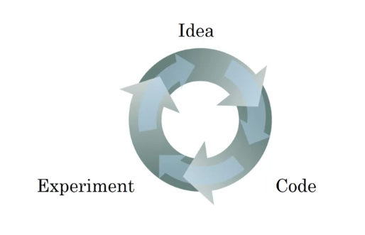
1.1 Train / Dev / Test sets
Applied Machine Learning (ML) is a highly iterative process.
model generalization.
Splitting into train, dev & test sets:
Training sets: to build model.
Dev sets (validation sets): to optimize hyperparameters
Test sets: try & evaluate.
Notes:
Dev & test set from same distribution.
The trend on the ratio of splitting the models:
100 ≤ #datasets ≤ 10^6 => 60%/20%/20%.
#datasets ≥ 10^6 => 98%/1%/1%.
The factors determining ML’s ability:
Make the training error small.
Make the gap between training & test error small.

Slide 5
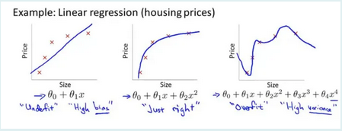
1.2 Bias/Variance (1)
Definition:
Bias: the difference between the average prediction & the correct value.
Variance: the variability of model prediction for a given data point which tells spread of our data.
Problems:
Overfitting: occurs when the gap between the training error & test error is too large.
Underfitting: occurs when the model is not able to obtain a sufficiently low error value on the training set.
The bias variance trade-off: try to find a good balance between bias & variance such that it minimizes the total error:

Slide 6
1.2 Bias/Variance (2)
Solving for overfitting:
Cross – validation.
Regularization .
With neural networks: weight decay & dropout.

Slide 7
1.3 Basic recipe for machine learning
After having trained an initial model
High bias
1. Try bigger network
2. Train longer
3. Try difference NN architecture
Yes
No
High variance
1. More data
2. Regularization
3. Try difference NN architecture
Yes
Done

Slide 8
1.4 Regularizing (1)
Regularizations are techniques used to reduce the error by fitting a function appropriately on the given training set & avoid overfitting.
Techniques:
Modify the loss function
Dropout
Early stopping

Slide 9



1.4 Regularizing (3)
Regularization for Logistic regession:
Cost function:
The L2 regularization:
The L1 regularization:
Notes:
What:
+ Overfitting:
+ Solves: regularization or more training data.
2) Why using ?
+ regularization: giam so luong models

Slide 10
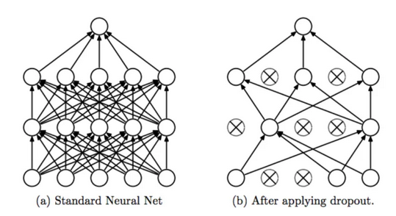
1.4 Regularization: Dropout
Dropout Regularization: remove some neurons/weights on each iteration based on a probability (p%).
=> reduce the neural networks complexity.

Slide 11
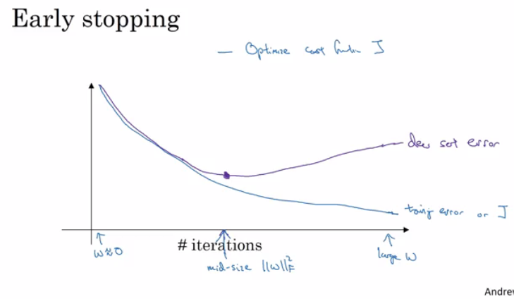
1.4 Regularization: Other methods
Data augmentation:
Get more data.
Example: In computer vision, we can flip, random rotations, random scale …
Early stopping:
At iteration which the dev set cost start increasing.
The stop point at which the lowest training cost & lowest dev cost.

Slide 12
Optimization Algorithms
02

Slide 13

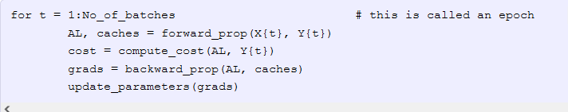
2.1 Mini-batch Gradient Descent (1)
Vectorization allows us to efficiently compute on m examples. Consider m=5,000,000:
Batch: all datasets
Mini-batch: subsets of datasets.
Example: Batch=5*10^6 ; mini-batches=1000; number of batches = 5000
Mini-batch Gradient Descent:
Run the gradient descent on the mini datasets.
Mini-batch algorithms pseudo code:

Slide 14
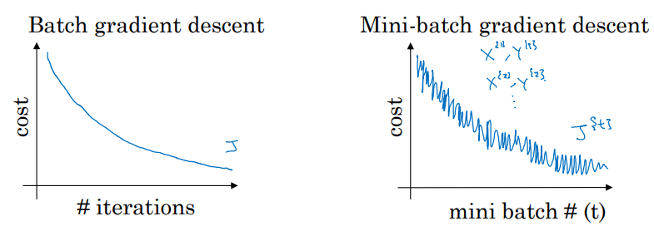
2.1 Mini-batch Gradient Descent (2)
Training with mini batch gradient descent:
Batch GD: expect the cost function (J) to go down on every single iteration.
downwards with a little bit noisier. Mini-batch GD: trend
Choosing mini-batch size, propose number of examples = m:
 | Batch gradient descent | Stochastic gradient descent | Mini-batch gradient descent
Mini-batch size | m | 1 | n, 1 < n < m
 | - Spend more time per iteration - Small training datasets (m< 2000) - Pros: requires a large amount of computer resources with the large training dataset. | The parameters of all the layers are updated after every training sample. | Fastest learning Often, n is a power of 2.

Slide 15
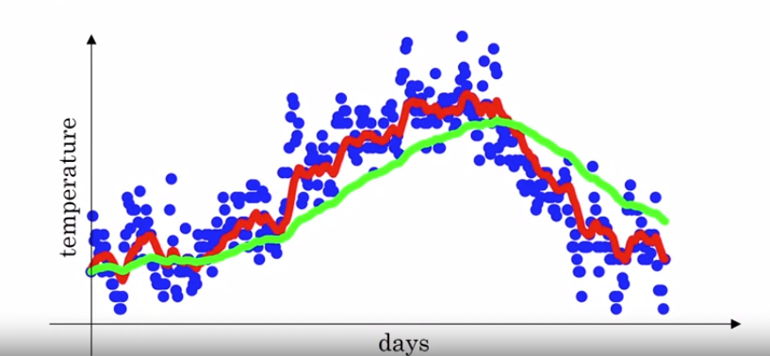
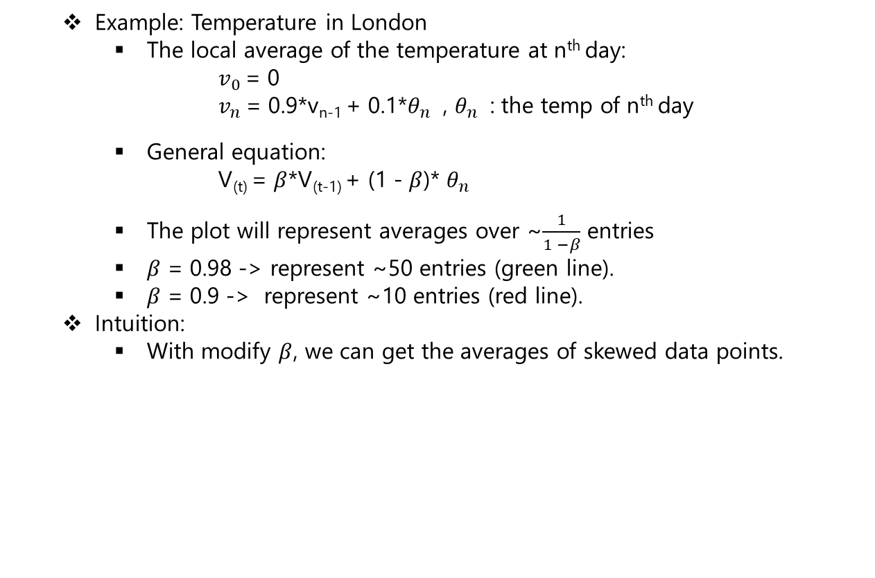
2.2 Exponentially Weighted Averages (1)
Example: Temperature in London
The local average of the temperature at n^{th} day:
$v_{0}$ = 0
$v_{n}$ = 0.9*v_{n-1} + 0.1*$θ_{n}$ , $θ_{n}$ : the temp of n^{th} day
General equation:
V_{(t)} = $β$*V_{(t-1)} + (1 - $β$)* $θ_{n}$
The plot will represent averages over ~$\frac{1}{1 −β}$ entries
$β$ = 0.98 -> represent ~50 entries (green line).
$β$ = 0.9 -> represent ~10 entries (red line).
Intuition:
With modify $β$, we can get the averages of skewed data points.

Slide 16
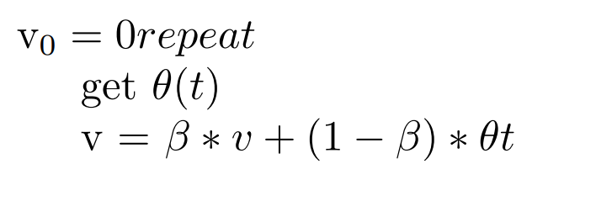
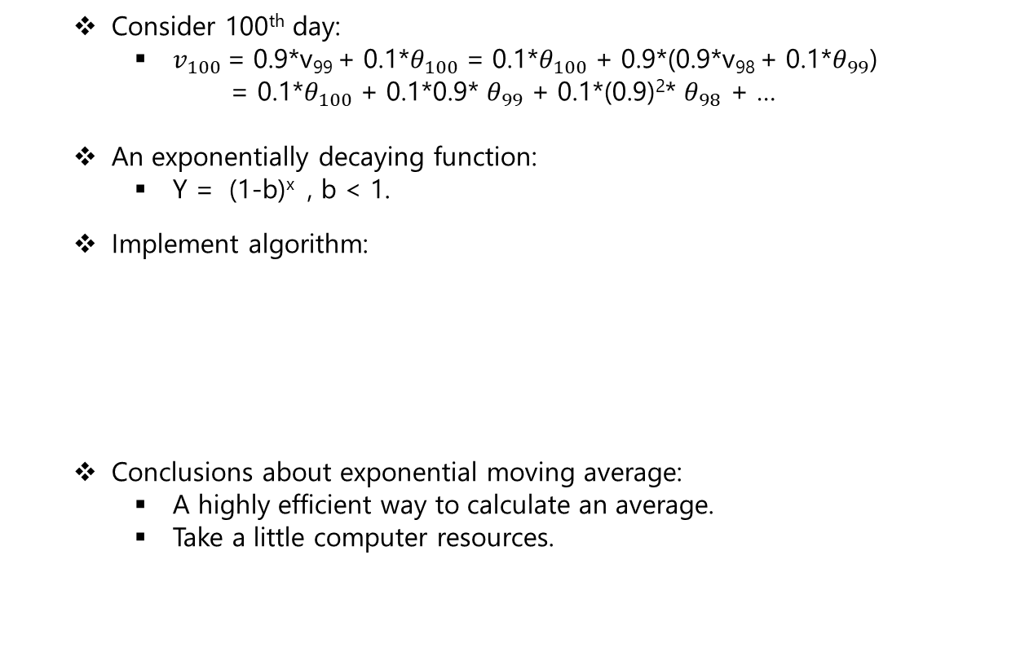
2.2 Exponentially Weighted Averages (2)
Consider 100th day:
$v_{100}$ = 0.9*v₉₉ + 0.1*$θ_{100}$ = 0.1*$θ_{100}$ + 0.9*(0.9*v₉₈ + 0.1*$θ_{99}$)
= 0.1*$θ_{100}$ + 0.1*0.9* $θ_{99}$ + 0.1*(0.9)²* $θ_{98}$ + …
An exponentially decaying function:
Y = (1-b)^{x} , b < 1.
Implement algorithm:
Conclusions about exponential moving average:
A highly efficient way to calculate an average.
Take a little computer resources.

Slide 17
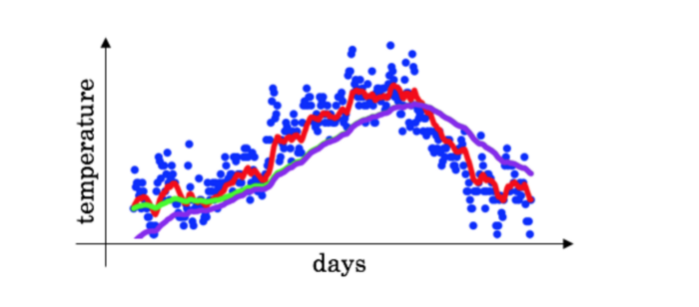
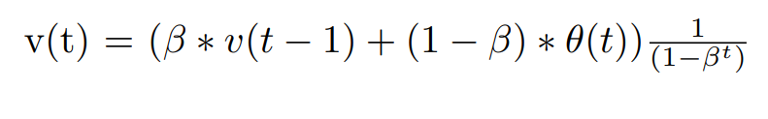
2.3 Bias Correction in Exponentially Weighted Averages
The bias correction helps make the exponentially weighted averages more accurate.
If the curve starts from 0, not many values to average on in the initial days.
If the curve lower than the correct value initially & then take time to moves in line with expected values.
To solve the bias issue:

Slide 18
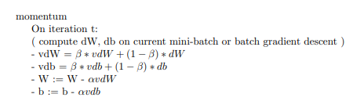
2.4 Gradient Descent with Momentum
Idea: Calculate the exponentially weighted averages for gradients & then update weights with the new values.
Pseudo code:
Momentum helps the cost function to go the minimum point in a more fast & consistent way.

Slide 19
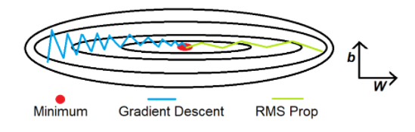
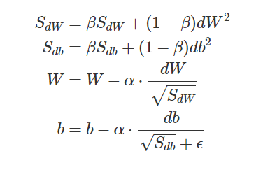
2.5 Root Mean Square Propagation
A technique to dampen out the motion in the bias (b) & speed up gradient descent.
Square the derivatives of both w & b.
Goals: Reduce the large number dW & db.
Pseudo code:

Slide 20
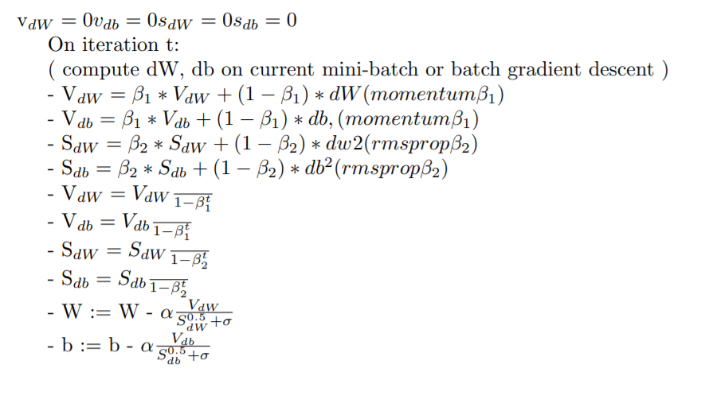
2.6 Adam Optimization Algorithms
Adam optimization simply puts RMS prop & momentum together.
Pseudo code:

Slide 21
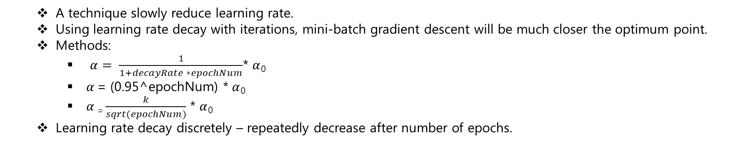
2.7 Learning Rate Decay
A technique slowly reduce learning rate.
Using learning rate decay with iterations, mini-batch gradient descent will be much closer the optimum point.
Methods:
$α= \frac{1}{1+decayRate ∗epochNum}$* $α$₀
$α$ = (0.95^epochNum) * $α$₀
$α$ ₌ $\frac{k}{sqrt(epochNum)}$ * $α$₀
Learning rate decay discretely – repeatedly decrease after number of epochs.

Slide 22
Hyperparameter Tuning, Batch Normalization & Programming Frameworks
03

Slide 23
3.1 Tuning process
Goal: tune model’s hyperparameters to get the best sets.
Hyperparameters:
Learning rate
Momentum beta
Mini-batch size
No. of hidden units
No. of layers
Leaning rate decay
Regularization lambda
Activation functions.
Adam, beta1, beta2 & epsilon.
Notes:
What:
+ Overfitting:
+ Solves: regularization or more training data.
2) Why using ?
+ regularization: giam so luong models

Slide 24
3.2 Using an appropriate scale to pick hyperparameters
Goal: tune model’s hyperparameters to get the best sets.
Hyperparameters:
Learning rate
Momentum beta
Mini-batch size
No. of hidden units
No. of layers
Leaning rate decay
Regularization lambda
Activation functions.
Adam, beta1, beta2 & epsilon.

Slide 25
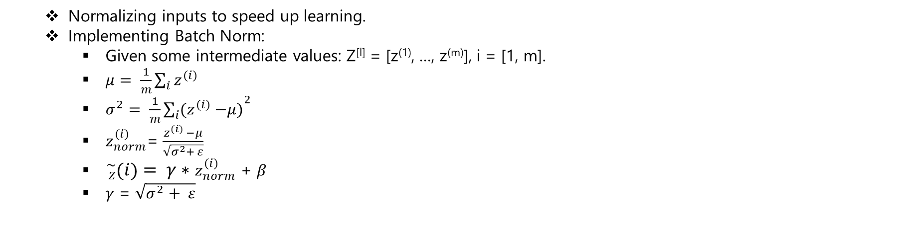
3.3 Batch Normalization: Normalizing activations in a Network
Normalizing inputs to speed up learning.
Implementing Batch Norm:
Given some intermediate values: Z^{[l]} = [z⁽¹⁾, …, z^{(m)}], i = [1, m].
$μ= \frac{1}{m}\sum_{i}{z^{(i)}}$
$σ^{2}= \frac{1}{m}{\sum_{i}{{(z}^{(i)} −μ)}}^{2}$
$z_{norm}^{(i)}$= $\frac{z^{(i)} −μ}{\sqrt{σ^{2}+ ε}}$
${}_{Z}^{\sim }{\left(i\right)= γ∗}$ $z_{norm}^{(i)}$ + $β$
$γ$ = $\sqrt{σ^{2}+ ε}$

Slide 26
3.3 Batch Normalization: Fitting batch normalization into a NN
Normalizing inputs to speed up learning.
Implementing Batch Norm:
Given some intermediate values: Z^{[l]} = [z⁽¹⁾, …, z^{(m)}], i = [1, m].
$μ= \frac{1}{m}\sum_{i}{z^{(i)}}$
$σ^{2}= \frac{1}{m}{\sum_{i}{{(z}^{(i)} −μ)}}^{2}$
$z_{norm}^{(i)}$= $\frac{z^{(i)} −μ}{\sqrt{σ^{2}+ ε}}$
${}_{Z}^{\sim }{\left(i\right)= γ∗}$ $z_{norm}^{(i)}$ + $β$
$γ$ = $\sqrt{σ^{2}+ ε}$

Slide 27
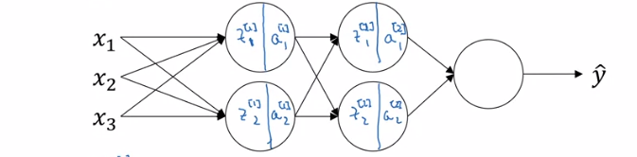

3.3 Batch Normalization: Why does batch normalization work ?
Fitting batch normalization into a neural network
Consider 3 hidden layers NN.
NN parameters: W^{[1]}, b^{[1]}, W^{[2]}, b^{[2]}, beta^{[1]}, alpha^{[1]}, beta^{[2]}, alpha^{[2]}
Shapes:
beta^{[l]}, z^{[l]}, gamma^{[l]} – (n^{[l]}, m)
Why dose batch normalization work ?
Normalize X
Batch normalization reduces the problem of input values changing.

Slide 28
Thank you

